Slide 1

BUSINESS INTELLIGENCE PROJECT · 2026–2027
Market Price Intelligence from Daily Mandi Data
Cleaning, warehousing and analyzing Indian agricultural market prices for Business Intelligence.
Department of CSE (Data Science)

Slide 2

A detailed feed was difficult to compare across markets
AGMARKNET reports minimum, maximum and modal wholesale prices for each market and commodity.
Raw headers carried encoding artifacts, text fields contained stray spaces, and the source published only the current day.
The project goal: turn a hard-to-query feed into a structured source for market, commodity and state comparisons.

Slide 3
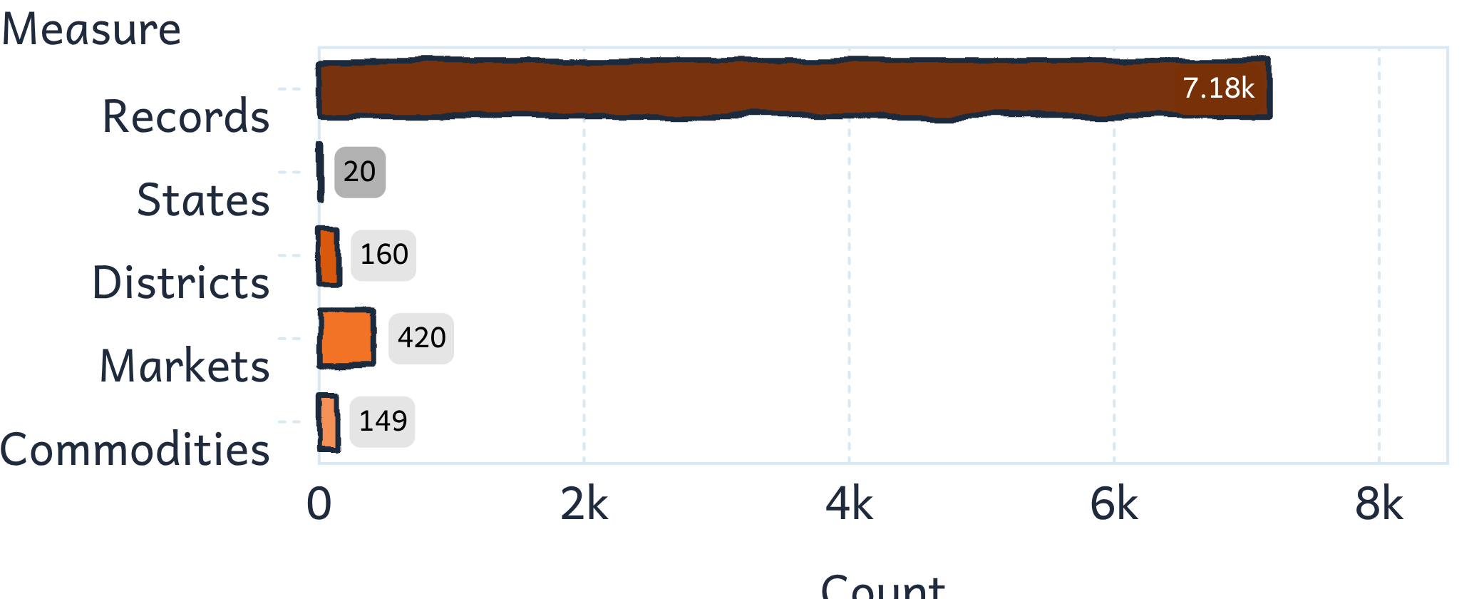
The snapshot covered 7,181 records across 20 states
The snapshot is broad in entities but narrow in time.
Entity coverage
420 markets · 160 districts · 149 commodities
218 varieties · 12 grade labels
All records share one arrival date: 28 July 2026. Prices are reported in rupees per quintal.

Slide 4

Validation passed
Cleaning created a reliable analytical base
Every validation check passed: 0 missing values, 0 duplicates and 0 invalid price-order rows.
Rename encoded price columns and standardize text fields.
Convert arrival dates and prices to usable types.
Derive price spread and spread percentage.
Validate missing values, duplicates, price order and negative prices.
Load the cleaned 15-column file without removing records.

Slide 5

The star schema made the feed easy to query
The warehouse separates measurable prices from descriptive context.
One fact table, fact_market_price, stores min, max, modal, spread and spread percentage.
Five dimensions describe date, location, commodity, variety and grade.
The fact table retained all 7,181 cleaned records.
Date dimension
Descriptive context
Grade dimension
Location dimension
fact_market_price
Descriptive context
Descriptive context
Variety dimension
Commodity dimension
Descriptive context
Descriptive context

Slide 6



Seven business questions became one interactive dashboard
Rank
Compare
Measure
Commodities, markets and states by average modal price.
Minimum, maximum and modal prices.
Price spread and compare grades.
POWER BI · MYSQL WAREHOUSE
Rs 5,519.21
Power BI connected directly to the MySQL warehouse.
Average modal price
Rs 672.68 average spread · 149 commodities · 420 markets

Slide 7
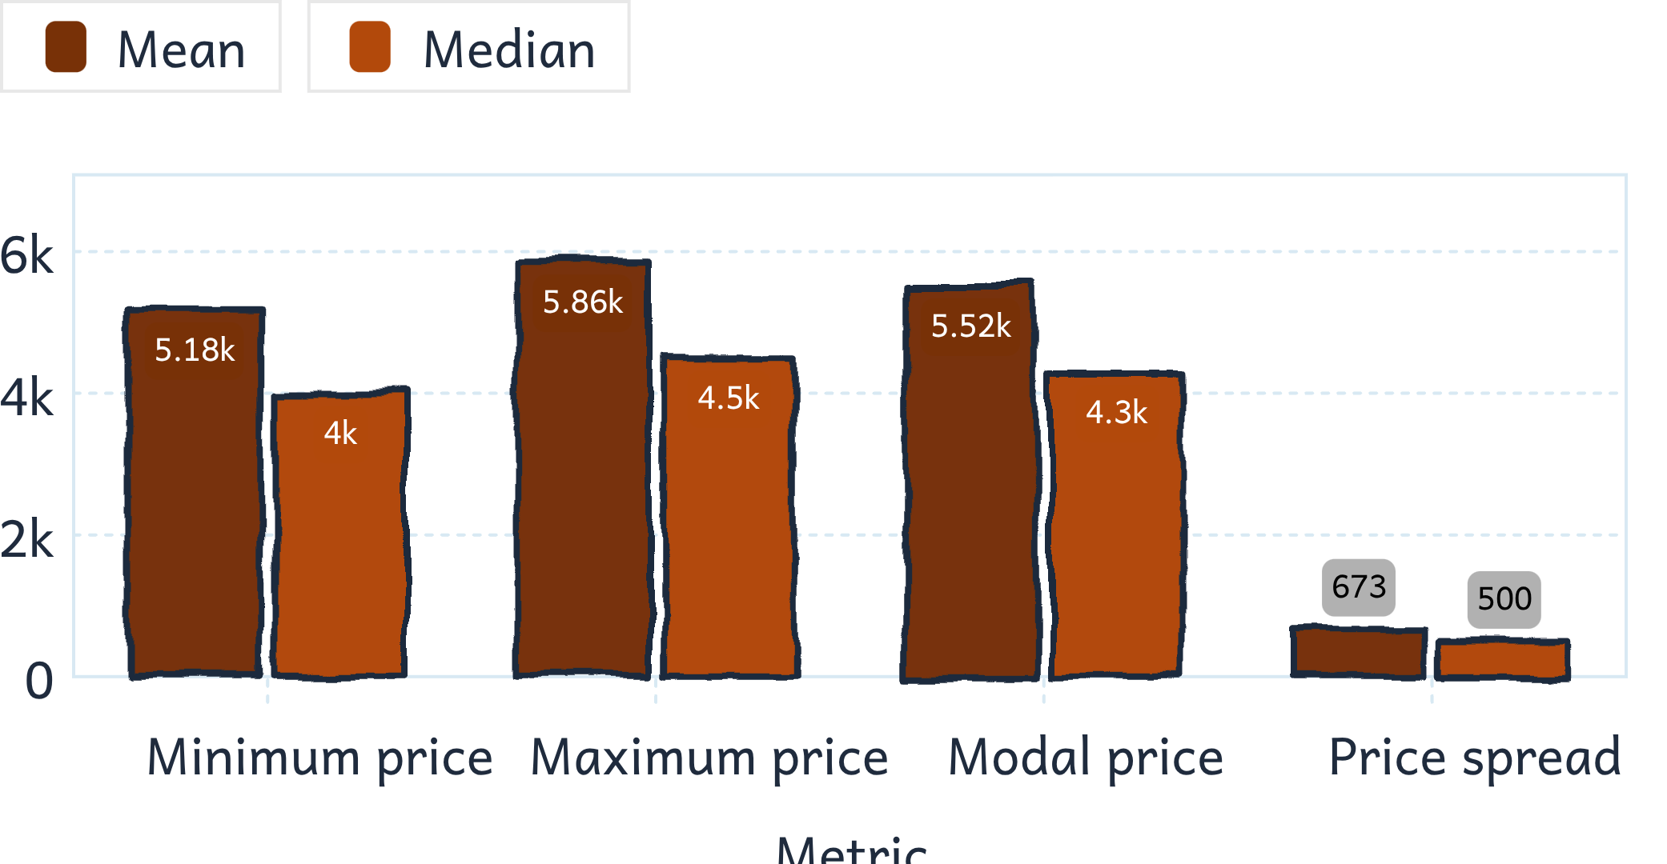
The overall market was right-skewed
Mean sits above median
Average modal price: Rs 5,519 per quintal.
Median modal price: Rs 4,300.
High-value flowers, spices and ghee pull the mean upward.

Slide 8
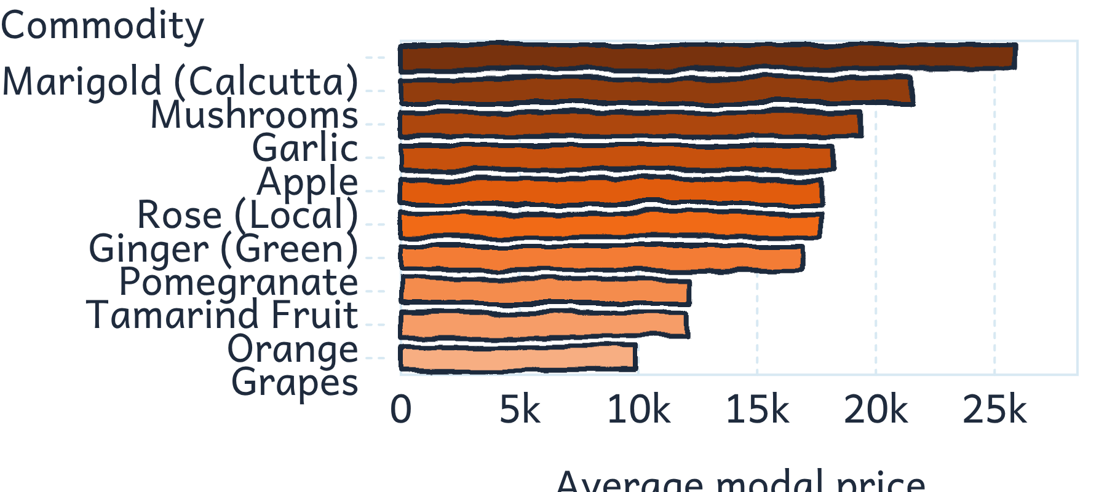
High-value commodities were led by marigold and mushrooms
Among commodities with at least 20 records, marigold averaged Rs 25,889 per quintal; mushrooms averaged Rs 21,633; garlic averaged Rs 19,328; apple averaged Rs 18,227.
Pumpkin, tomato and watermelon were the lowest-priced commodities in this filtered comparison. Filtering by record count prevents one-off reports from dominating the ranking.

Slide 9
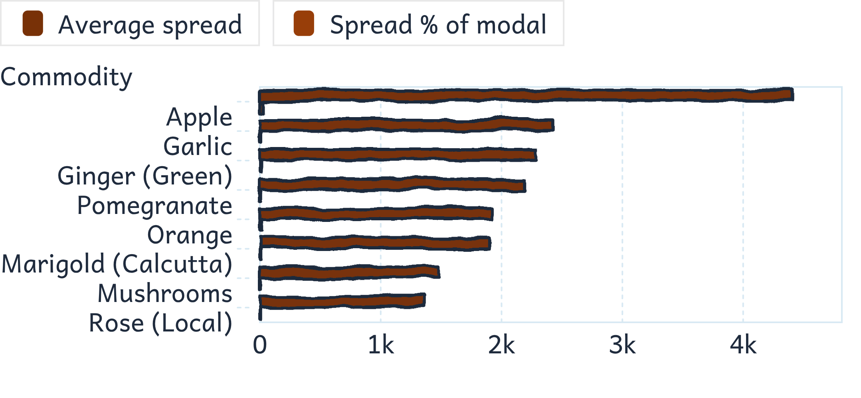
Apple carried the widest price spread
Rs 4,419
Apple's average spread, equal to 28.3% of its modal price.
Marigold combined the highest average price with a narrower 6.9% spread.
A wide one-day spread may reflect quality differences between lots, not only instability.

Slide 10
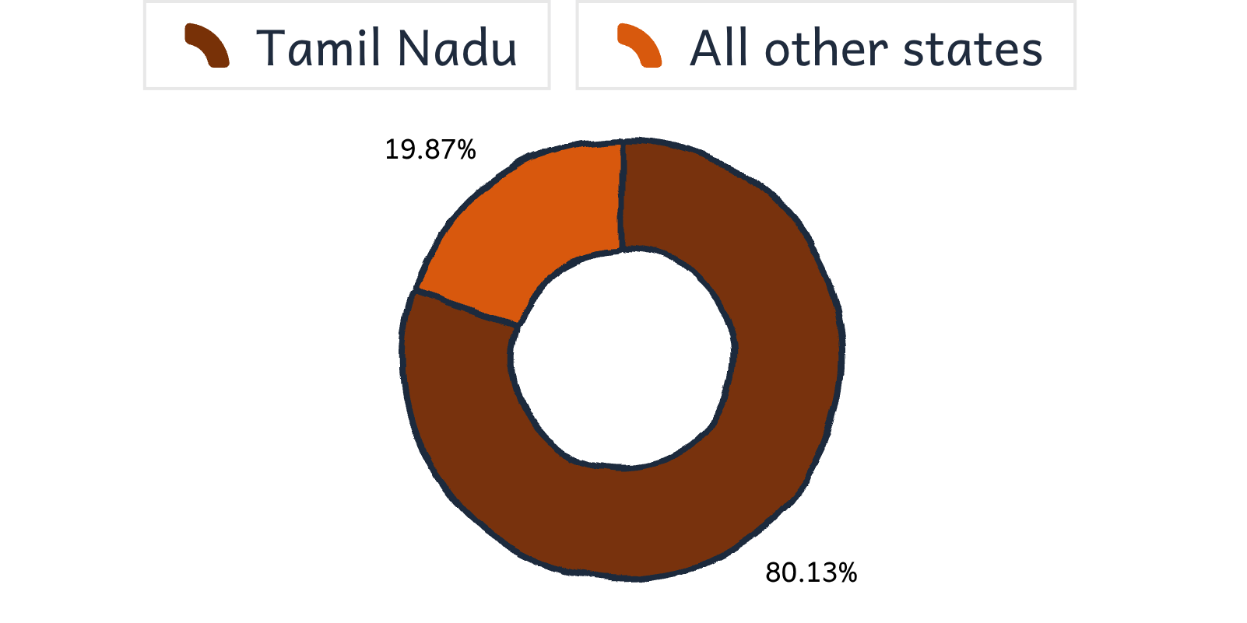
Market and state averages reflected reporting mix
Decision-quality checkpoint
Ramanathapuram (Uzhavar Sandhai) led filtered market averages at Rs 11,743 across 43 records.
Andaman and Nicobar had the highest state average at Rs 8,786, but from 23 records at one market.
A market or state average is partly a measure of which commodities were reported.
Tamil Nadu supplied 5,754 records, or 80.1% of the snapshot, across 151 markets.

Slide 11
Limitations shape how far the numbers can be used
Read these caveats before comparing markets, commodities or states.
Snapshot & sample depth
Price-record caveats
One arrival date—28 July 2026—cannot show day-to-day movement. 224 of 420 markets have fewer than 10 records; 45 commodities have three or fewer.
1,635 records have no spread between minimum and maximum price. 16 modal prices below Rs 100 warrant a check before ranking.

Slide 12
Future scope extends the pipeline beyond one snapshot
Build a dependable feed
Make comparisons useful
Forecast with context
Schedule daily pulls and standardize commodity, variety and grade labels across sources.
After history accumulates, develop time-series forecasts and test weather, demand-supply and transport effects on prices.
Strengthen dashboard filters and state views; track price trends across dates.

